Slide 1
Nerdy Nets – GPT2

Slide 2
Model Overview
Query Algorithm
Transformer/LSTM algorithm
GPT-2 algorithm
Model loss
GPT-2 loss
Original paragraph (400 words)
Generated paragraph (400 words)
Generated summary (100 words)

Slide 3
Preprocess
TLDR reddit dataset in JSON format
Paragraph’s cleaned and padded to paragraph_window_size (100)
Summaries cleaned and padded to summary_window_size (100)

Slide 4
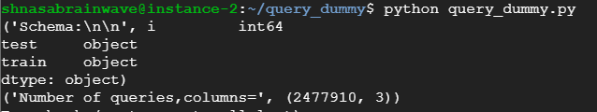
Query Algorithm
Outputs the relevance of keywords to some specific documents using TD-IDF (Term Frequency - Inverse Document Frequency)
Preprocessed data is further preprocessed to remove the
stop-words and punctuations.
II. Extract the JSON schema (train and test)
III. Create vocabulary and Word Counts for IDF
Compute IDF values.
Extracting keywords
Sort the values in the vector while preserving the column index of the extracted keyword.
Return the sorted values.

Slide 5
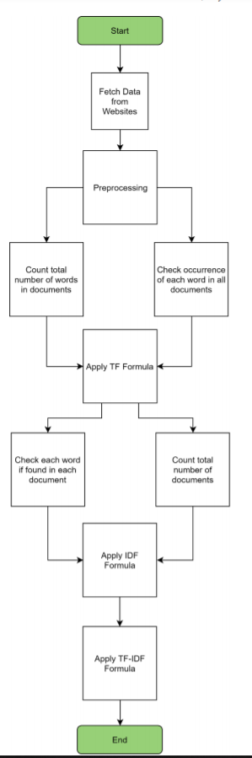
Overview
of
Query Algorithm

Slide 6
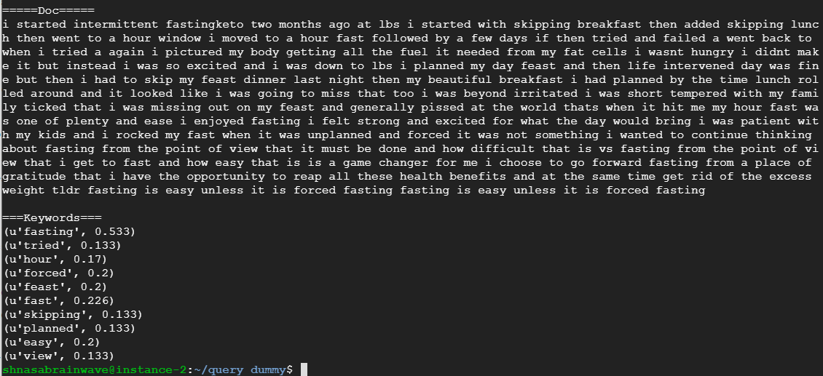
Result

Slide 7
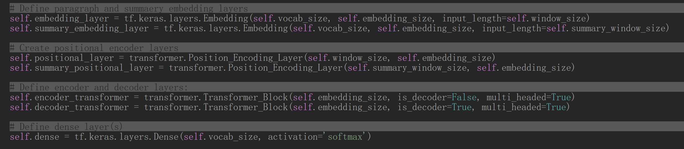
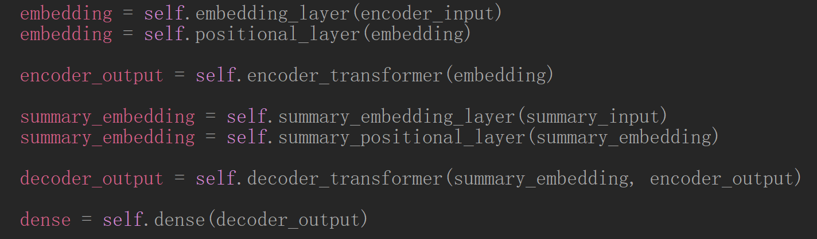
Transformer Algorithm
sizes
Encoder size = decoder size = 15
Window size = summary window size = 100
Vocab size = 717515

Slide 8
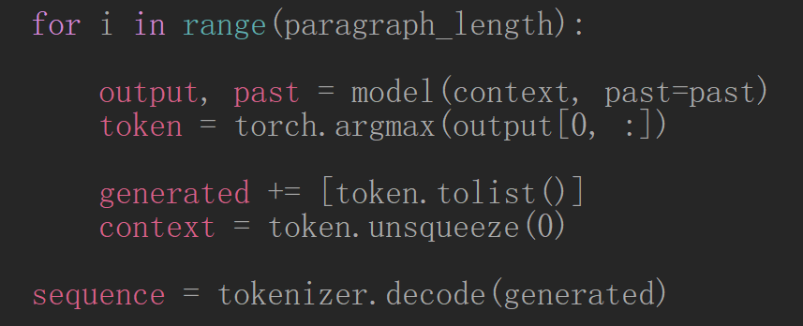
GPT-2 Algorithm
OpenAI GPT-2 model 124M parameter model (smallest) trained on 40GB of text data

Slide 9
Results

Slide 10
GPT-2 example

Slide 11
Discrepencies
Paragraph window size should be larger than summary window size

